Slide 1

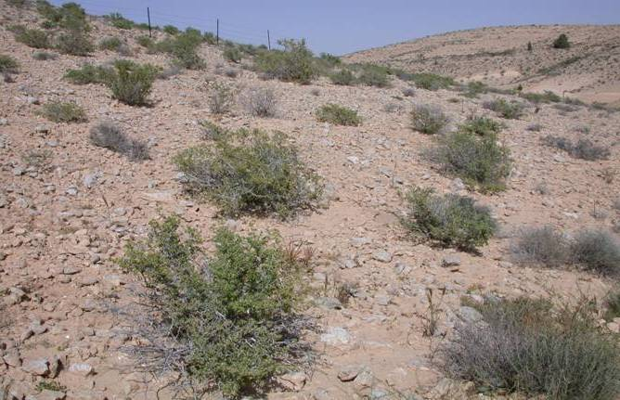
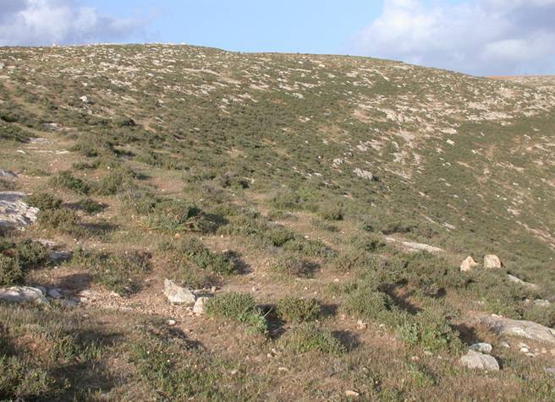
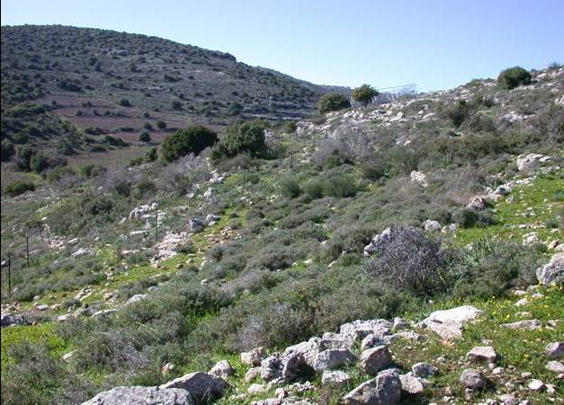
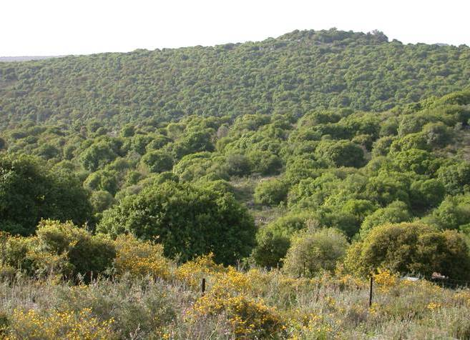
Climate change in unpredictable terrestrial ecosystems: an integrative approach along an aridity gradient in Israel
Marcelo Sternberg
Department of Molecular Biology & Ecology of Plants
Tel Aviv University, Israel

Slide 2
GLOWA – Jordan River
Soil moisture
Climate change
Land use change
GLOWA
+ & - feedbacks
Global water cycle
Evapo-transpiration & evaporation
Water vapor (dew & air humidity
Water cycle: dominant cause of uncertainty in climate change projections

Slide 3
Green water: terrestrial ecosystems
Precipitation–the basic water resource
GW
GW
GW
GW
GW
Falkenmark 2003

Slide 4

GLOWA – Jordan River
What will happen to natural ecosystems and their “users”?
Or….
Being a prophet in the “Land of Prophets”……
………a tough job

Slide 5
Research partners
Alon Angert, Jose Gruenzweig, Jaime Kigel, Irit Konsens
The Hebrew University of Jerusalem, Israel
Yossi Steinberger
Bar-Ilan University, Israel
Katja Tielboerger
Tuebingen University, Germany

Slide 6
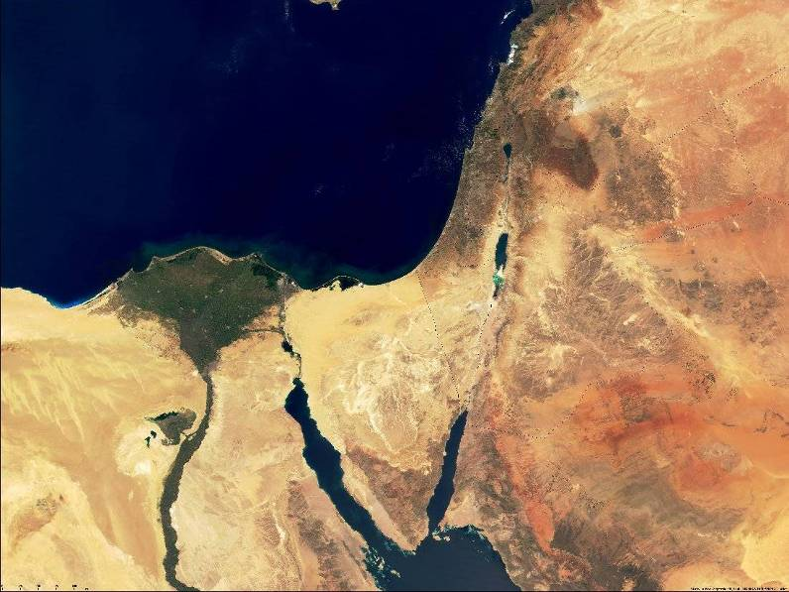
Global Climate Change in the Middle East
Current global climate change models predict changes in temperature and rainfall in the Mediterranean basin region.
Higher summer & autumn temperatures
Lower winter rainfall
Black, 2009; Klafe & Bruins, 2009

Slide 7
Study sites
The gradient:
Arid
Semiarid
Mediterranean
Mesic Mediterranean

Slide 8
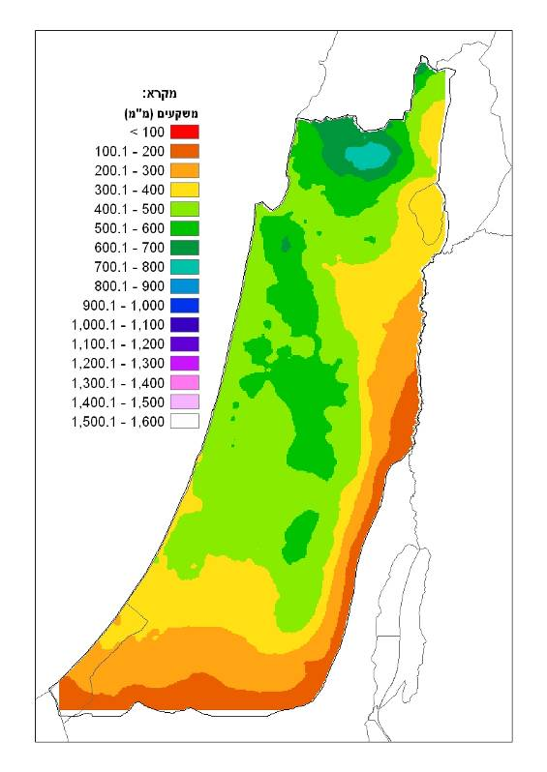
Rainfall (mm)
Rainfall along the aridity gradient
Source: IMS

Slide 9
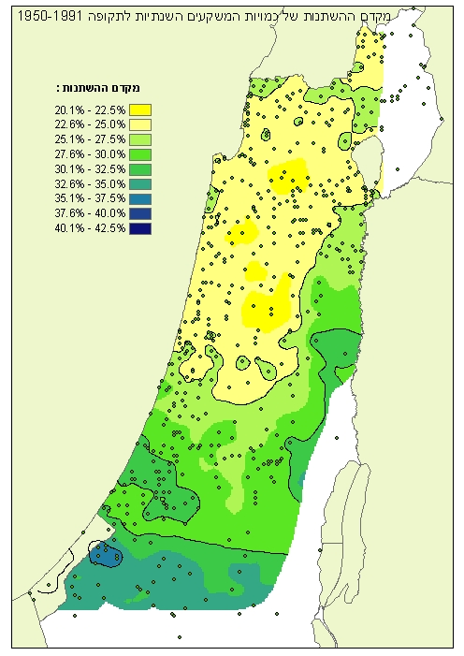
Rainfall CV (%)
Rainfall predictability along the aridity gradient
Source: IMS

Slide 10
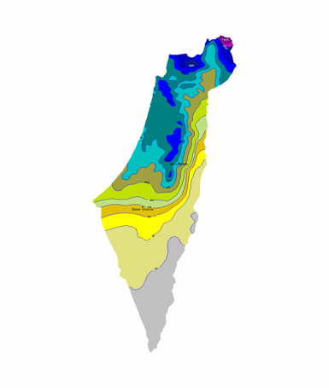
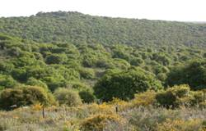
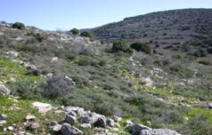
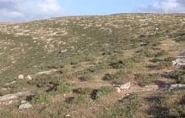
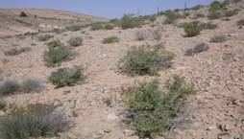
Aridity gradient
Mesic Mediterranean - 780 mm – CV 22%
Topography
South-facing slopes with stony and shallow soil (Terra rossa to desert lithosol on hard limestone and chalk)
Temperature
Mean annual temperature 18⁰C-19⁰C
Rainfall
Mainly winter - 5 summer months with no rainfall
Range North-South:
780 to 90 mm
~ 245 km
Mediterranean - 540 mm – CV 30%
Semiarid – 300 mm – CV 37%
Arid – 90 mm – CV 51%

Slide 11
Rainfall along the gradient
800
795 mm
Mesic Mediterranean
700
Mediterranean
Semiarid
Arid
609 mm
600
500
Rainfall (mm)
400
300
270 mm
200
100 mm
100
0
Oct-06
Dec-06
Feb-07
Apr-07
Jun-07
Aug-07
Oct-07
Date
Differences in length of the growing season
Talmor et al., 2010 GCB

Slide 12
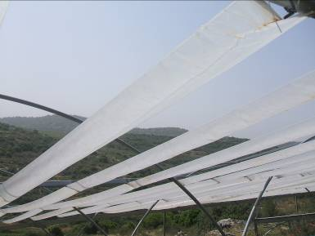
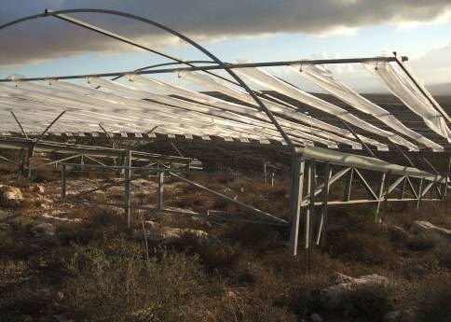
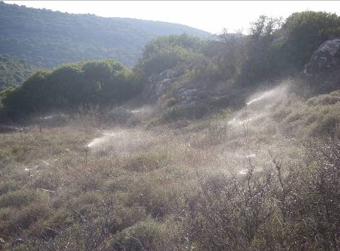
Experimentally testing the effects of climate change
Rainout Shelters (25 x 10 m) – 30% reduction
Sprinkler Irrigated Plots
(25 x 10 m) – 30% increase

Slide 13
Experimental design
Mesic Mediterranean 780 mm
N
Supplemented rainfall
Drought
Mediterranean 540 mm
Semiarid 300 mm
Arid 90 mm

Slide 14
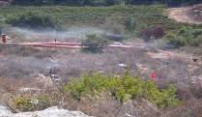
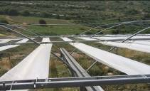
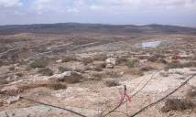
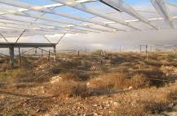
Experimental design
EIN - Mesic Mediterranean 780 mm
N
Supplemented rainfall
Drought
MAT Mediterranean 540 mm
LAH Semiarid 300 mm
SDE Arid 90 mm

Slide 15
Data collection – Gradient vs. manipulation data
Gradient
Rainfall manipulations
Vegetation NPP Species richness Species diversity Soil seed banks Seedling mortality
Ecosystem Soil respiration NO₃, NH₄ & PO₄ P (d¹⁸O_{p} ) Soil microbial biomass Soil Fungi Plant root and litter decomposition
Soil mesofauna Ground insect (beetles)
Vegetation NPP Species richness Species diversity Soil seed banks Seedling mortality
Ecosystem Soil respiration NO₃, NH₄ & PO₄ P (d¹⁸O_{p} ) Plant litter decomposition
Soil mesofauna Ground insects (beetles)
Notes:
hierarchical models are validated at each level, passing up information from the finest scale to the coarsest scale. Only at the finer scales, model projections can be tested experimentally. Each level with new factors requires validation

Slide 16
Results
The gradient:
Arid
Semiarid
Mediterranean
Mesic Mediterranean

Slide 17
Soil nutrients along the gradient
NO₃⁻ increased with increasing rainfall – P decreased at the most mesic site – seasonal changes
Arid
Semiarid
Mediterranean
Mesic Med.
Time

Slide 18
Soil nutrients along the gradient
N and OC increases with increasing rainfall – seasonal changes
Arid
Semiarid
Mediterranean
Mesic Med.
% N
Time

Slide 19
Primary productivity along the gradient
Linear relationship between annual rainfall and herbaceous biomass production until 450 mm
Arid
Semiarid
Mediterranean
Mesic Med.
Kigel et al., unpublished

Slide 20
Species richness along the gradient
No linear relationship between rainfall & spp. richness at the mesic sites
Arid
Semiarid
Mediterranean
Mesic Med.
2002
2003
2004
2005
2006
2007
2008
2009
2010
Year
Kigel et al., unpublished

Slide 21
Species richness and rainfall along the gradient
Arid
Semiarid
Mediterranean
Mesic Med.
Kigel et al., unpublished

Slide 22
Species richness & APP correlation along the gradient
Arid
Semiarid
Mediterranean
Mesic Med.
Kigel et al., unpublished

Slide 23
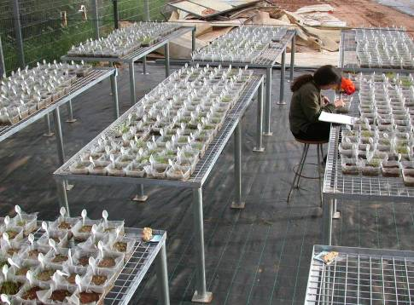
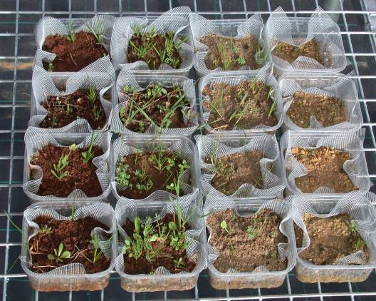
Soil seed bank

Slide 24
Changes in seed bank density along the aridity
gradient
Station *** Year *** S x Y ***
Mean No of seedlings (m⁻²)
Year
Important differences among sites & years
Strong densities variation with rainfall at the mesic sites
arid
semiarid
Mediter.
mesic Mediter.

Slide 25
Changes in community structure along the aridity gradient
Station *** Year *** S x Y ***
Station *** Year *** S x Y **
Species richness
Species diversity (H’)
Important differences among sites.
No linear relation between rainfall and spp. richness & diversity.
Decreasing trend of spp. richness at the more mesic sites
arid
semiarid
Mediter.
mesic Mediter.
Species evenness (J’)
Station *** Year *** SxY **
Year

Slide 26
Experimentally testing the effects of climate change
Rainout Shelters (25 x 10 m) – 30% reduction
Sprinkler Irrigated Plots
(25 x 10 m) – 30% increase

Slide 27
Climate treatment effects on primary productivity
Rainfall manipulations had a significant effect on biomass production at the semiarid station only
Year ***
Treatment **
T x Y NS
Year ***
Treatment NS
T x Y NS
Year
Kigel et al., unpublished

Slide 28
Climate treatment effects on primary productivity
Effective rainfall manipulations had a significant effect on biomass production at the semiarid station only
Kigel et al., unpublished

Slide 29
Effects of rainfall manipulations on seed bank density
Semiarid
Mediterranean
Treat. NS Year *** T x Y NS
Treat. NS Year *** T x Y NS
Rainfall (mm)
Mean No of seedlings (m⁻²)
Year
drought
control
watering
rainfall

Slide 30
No treatment effect on seed bank density
Semiarid
Mediterranean
Treat. NS Year *** T x Y NS
Treat. NS Year *** T x Y NS
Rainfall (mm)
Mean No of seedlings (m⁻²)
Year
drought
control
watering
rainfall

Slide 31
Effects of rainfall manipulations on community
structure – Mediterranean site
Treat. NS Year *** T x Y NS
Treat. NS Year *** T x Y NS
Species richness
Species diversity (H’)
Rainfall (mm)
Year
drought
control
watering
rainfall

Slide 32
No rainfall manipulations effects on community
structure – Mediterranean site
Treat. NS Year *** T x Y NS
Treat. NS Year *** T x Y NS
Species richness
Species diversity (H’)
Rainfall (mm)
Year
drought
Similar results at the semiarid site
control
watering
rainfall

Slide 33


Slide 34
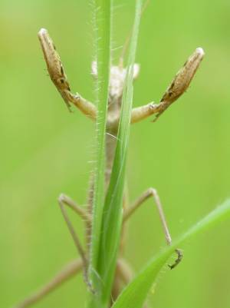
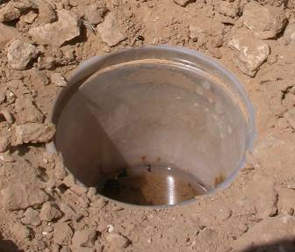
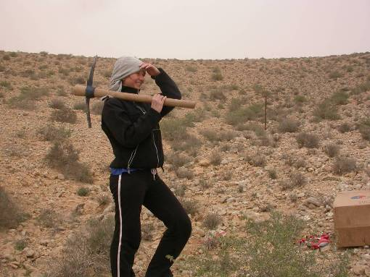
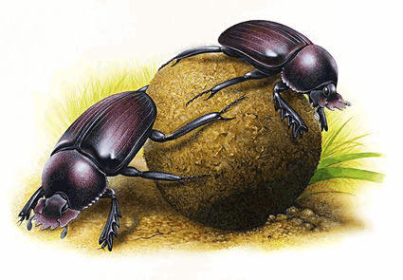
Effects of rainfall manipulations on insect density
Shtirberg et al., unpublished

Slide 35
Effects of rainfall manipulations on insect density
Semiarid
Mediterranean
Treat. NS Year *** T x Y NS
1400
Treat. NS Year *** T x Y NS
1400
1200
1200
Mean No of insects
1000
1000
800
800
600
600
400
400
200
‘06
‘07
‘06
‘07
‘06
‘07
200
‘06
‘07
‘06
‘07
‘06
‘07
0
0
Drought
Control
Watering
Drought
Control
Watering
Treatment
Treatment
Shtirberg et al., unpublished

Slide 36
Rainfall, soil moisture & soil respiration
45
90
40
Mediterranean
80
35
Open
70
30
60
Volumetric SWC (%)
25
50
Rainfall (mm)
20
40
15
30
10
20
5
10
0
0
10
Wet
Control
Dry
8
R_{s} (µmol CO₂ m⁻² s⁻¹)
6
4
Talmor et al., 2011
GCB
2
0
Jan-06
Apr-06
Jul-06
Oct-06
Jan-07
Apr-07
Jul-07
Oct-07
Notes:
התוצאות יהיו דוגמאות מאתרים שונים ובקומבינציות שונות של טיפולים ובתי גידול (ותוצאות עיקריות). נשימת קרקע ביחידות של שטף. 2 עונות עיקריות. התאמה עונתית טובה בין נשימה ללחות.

Slide 37
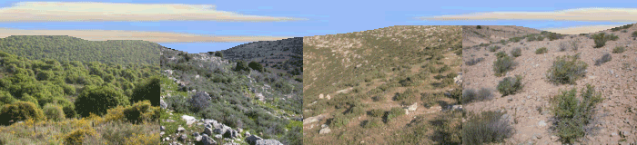
Soil respiration & rainfall manipulations
p<0.05
1000
Wet
A
AB
B
Control
800
Dry
600
R_{s} (g C m⁻² y⁻¹)
400
200
0
Open
Shrub
Open
Shrub
Mediterranean
Semiarid
Talmor et al., 2010
Notes:
מתחת לשיחים הבדל קטן יותר- הם ר"ש וייתכן כי עמידים יותר לשינויים קצרי טווח.

Slide 38
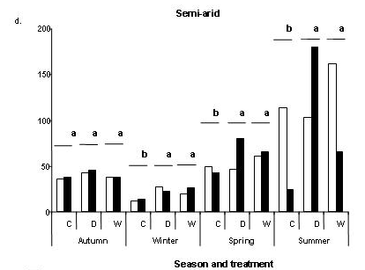
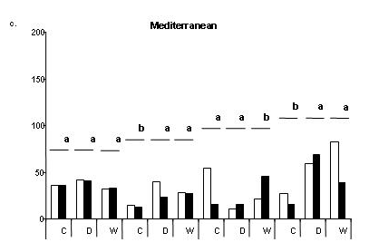
Effects of rainfall manipulations on soil microbial biomass
2008
Semiarid
2009
Mediterranean
Microbial biomass (µg C g soil⁻¹)
Autumn
Winter
Spring
Summer
2008 & ‘09 Seasons & Treatments
Season – significant changes No consistent pattern of treatment response
Sherman et al., unpublished

Slide 39
Conclusions
Soil nutrients, primary productivity, soil seed bank (SSB) density, species richness, species diversity varies strongly along the aridity gradient
No linear relationship between rainfall, NPP and species richness – P limitation at more mesic ecosystems?
Seed density correlates rainfall amounts (resource availability) along the aridity gradient, however differences among years are not necessarily reflected in higher number of seeds

Slide 40
Conclusions
The rainfall manipulations have not led to the hypothesized changes in soil properties, species density and community structure of the soil seed bank & insects. Plant communities proved to be resistant to this short-term climatic changes, particularly to drought. Increase of NPP at the semiarid indicates release of limiting factor.
We assume, that community resistance is mainly due to the vegetation “adaptation” to high temporal variability in rainfall, combined with high spatial heterogeneity. These characteristics buffers short-term changes.

Slide 41
Conclusions
Ecosystem level response (SR) to the rainfall manipulations indicates a different scale of response. Soil biota may respond faster to changes (i.e. higher generation turnover)
The detected short-term resistance does not necessarily imply resistance to long-term global climate change. More years are needed…..

Slide 42
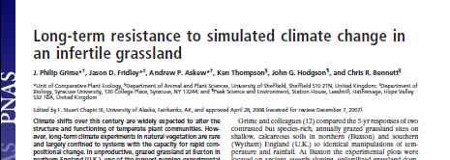
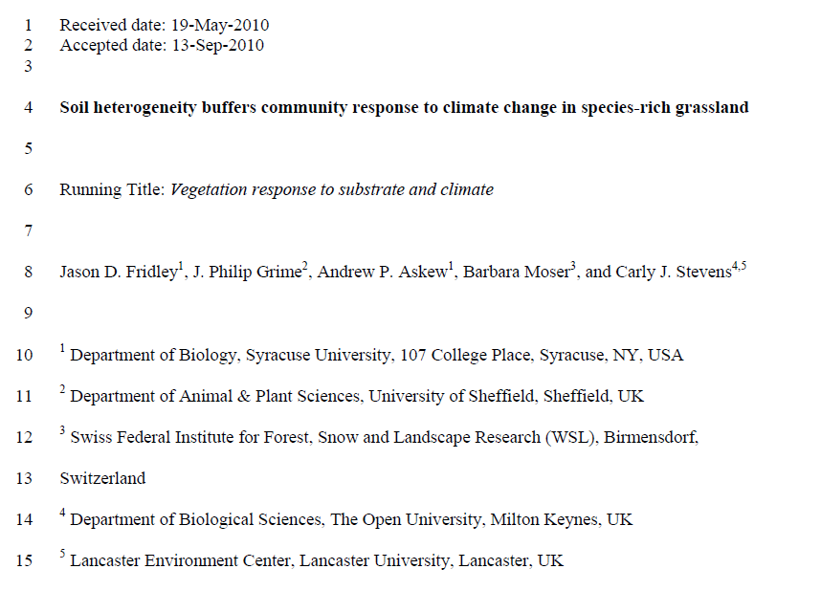
Conclusions
Eastern Mediterranean ecosystems have evolved under high climatic variability conditions, high levels of stress and perturbations – Ecosystems characterized by high spatial & temporal variability
Does this make them less vulnerable to climate change?
In press GCB

Slide 43
Take home message
Vulnerability to climate change decreases with increasing long-term climatic variability

Slide 44
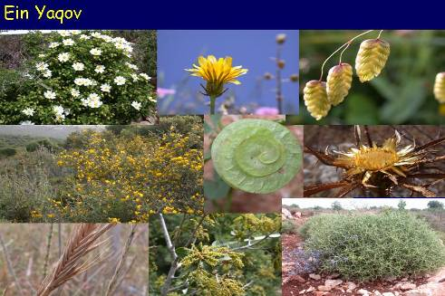
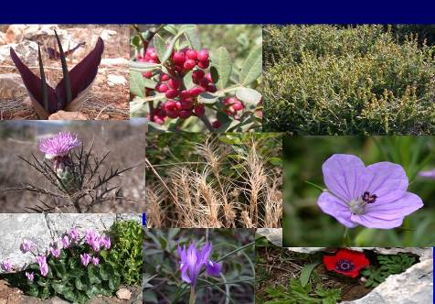
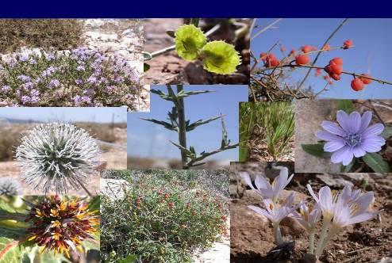
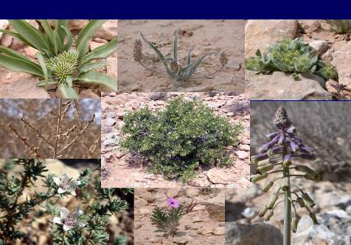
Thanks!!
Questions?
MarceloS@tauex.tau.ac.il

Slide 45
ᵦ species diversity – changes is composition similarity between stations and years
βsim (Simpson's based; reduces biases from imbalances in species richness between samples)
Similarity in species composition between and among stations decreased with time at the arid sites
 | Arid ‘02 | Semiarid ‘02 | Medit. ’02 | M. Med ‘02 | Arid ‘07 | Semiarid ‘07 | Med. ‘07 | M. Med ‘07
Arid ‘02 | -
Semiarid ‘02 | 0.57 | -
Medit. ‘02 | 0.39 | 0.64 | -
Mesic Med ‘02 | 0.43 | 0.55 | 0.64 | -
Arid 2007 | 0.39 | 0.65 | 0.57 | 0.39 | -
Semiarid ’07 | 0.39 | 0.74 | 0.62 | 0.57 | 0.70 | -
Medit. ’07 | 0.32 | 0.55 | 0.67 | 0.56 | 0.52 | 0.67 | -
M. Med ‘07 | 0.21 | 0.44 | 0.62 | 0.69 | 0.43 | 0.45 | 0.63 | -

Slide 46
Soil fungi species richness along the gradient
Arid
Semiarid
Mediterranean
Mesic Med.
Steinberger et al., unpublished

Slide 47
Shrub understory vs. open areas along the gradient Relative Interaction Intensity – Seedling density
0.5
***
0.4
a
0.3
0.2
ab
0.1
bc
RII index (S-O/S+O)
c
0
-0.1
-0.2
-0.3
-0.4
Arid
Semiarid
Medit.
Mesic. Medit.
-0.5
Sites along the gradient

Slide 48
Changes in germination strategies along
the aridity gradient
***
1st germination year
100
a
a
a
a
b
b
b
b
b
b
2nd germination year
b
ab
b
ab
ab
ab
a
a
a
3rd germination year
a
80
ab
ab
b
b
ab
ab
b
b
b
b
b
b
Germination (%)
a
a
a
a
60
b
b
Higher germination fractions at the arid extreme of the gradient
b
b
b
b
b
b
b
b
b
b
0
Arid
Semiarid
Medit
mesic
Medit
Site

Slide 49
Climate treatment effects on germination
strategies
Mediterranean
100
1st germination year
n.s
2nd germination year
80
3rd germination year
60
0
40%
Germination (%)
Drought
Control
Irrigation
Semiarid
100
n.s
80
60
0
Drought
Control
Irrigation
Treatment

Slide 50
No treatment effect
Mediterranean
100
1st germination year
n.s
2nd germination year
80
3rd germination year
60
0
40%
Germination (%)
Drought
Control
Irrigation
Semiarid
100
n.s
80
60
0
Drought
Control
Irrigation
Treatment

Slide 51
Plant density & species richness
Mediterranean station:
Density:
Strong temporal fluctuation.
Wet (and dry) lower than control
No treatment effect
Richness:
Weak temporal fluctuation, No change by treatment.
Semiarid site similar pattern!
Metz et al., 2010

Slide 52
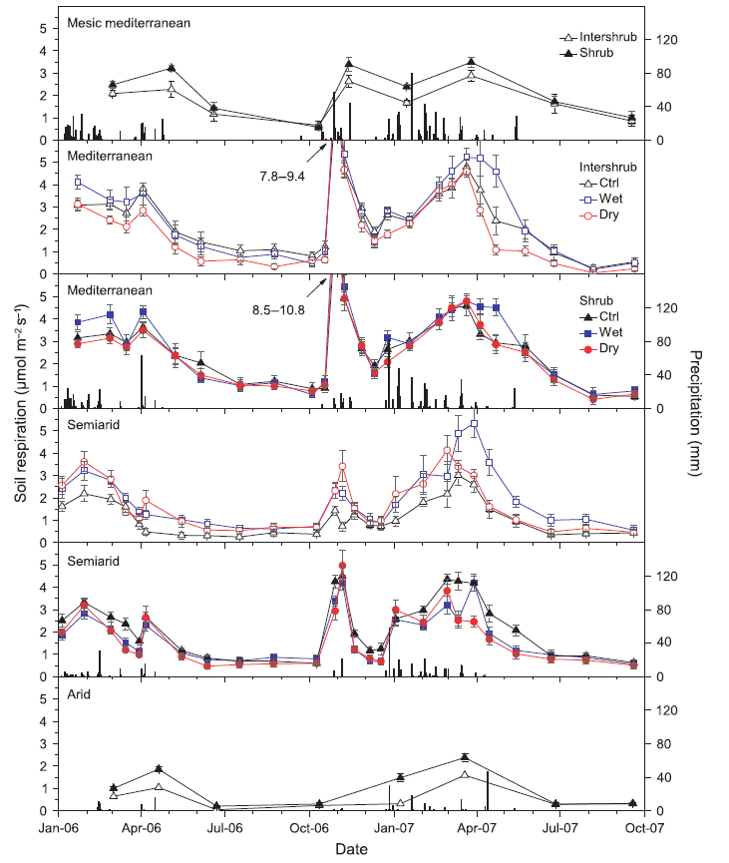
Soil respiration & rainfall manipulations
Notes:
מתחת לשיחים הבדל קטן יותר- הם ר"ש וייתכן כי עמידים יותר לשינויים קצרי טווח.

Slide 53
Shrub understory vs. open areas along the gradient - Species richness
Arid
mesic Mediterranean
Habitat *** Year *** H x Y NS
Habitat * Year *** H x Y NS
Rainfall (mm)
Species richness
Year
shrub
Habitat differential effect on species richness between arid vs. mesic Med.
No direct relationship between rainfall and spp. richness
open
rainfall

